Slide 1

Bootcamp Project #1
Anime recommendation dataset
Pic. “Samurai Champloo”
03.06.2022_Silvia Di Francescantonio

Slide 2
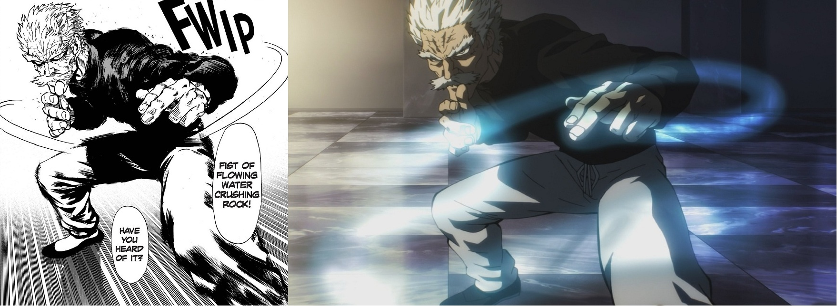


“Anime Recommendation Database 2020”
Found in https://www.kaggle.com/datasets
GitHub link: https://github.com/Hernan4444/MyAnimeList-Database
Description: information about 17.562 anime and the preference from 325.772 different users
MyAnimeList for providing anime data.
Jikan API for provide users preference.
MANGA
ANIME : SERIE
MANGA
ANIME : MOVIE

Slide 3

Steps:
Explore the data
Clean the data
Select the data for analysis
Analysis :
Explorative analysis
Model “% of dropping”

Slide 4
Explore the data
english_name | mal_id | score | type | episodes | premiered | studios | source | ranked | popularity | members | favorites | watching | completed | on-hold
Cowboy Bebop | 1 | 8,78 | TV | 26 | 1998 | Sunrise | Original | 28 | 39 | 1251960 | 61971 | 105808 | 718161 | 71513
Trigun | 6 | 8,24 | TV | 26 | 1998 | Madhouse | Manga | 266 | 201 | 558913 | 12944 | 29113 | 343492 | 25465
Witch Hunter Robin | 7 | 7,27 | TV | 26 | 2002 | Sunrise | Original | 2481 | 1467 | 94683 | 587 | 4300 | 46165 | 5121
Beet the Vandel Buster | 8 | 6,98 | TV | 52 | 2004 | Toei Animation | Manga | 3710 | 4369 | 13224 | 18 | 642 | 7314 | 766
Honey and Clover | 16 | 8,06 | TV | 24 | 2005 | J.C.Staff | Manga | 468 | 687 | 214499 | 4101 | 11909 | 81145 | 11901
Monster | 19 | 8,76 | TV | 74 | 2004 | Madhouse | Manga | 30 | 169 | 614100 | 29436 | 64648 | 214491 | 47488
Naruto | 20 | 7,91 | TV | 220 | 2002 | Studio Pierrot | Manga | 660 | 8 | 1830540 | 65586 | 137167 | 1462223 | 61734
The Prince of Tennis | 22 | 7,9 | TV | 178 | 2001 | Trans Arts | Manga | 675 | 1039 | 141832 | 3124 | 11235 | 76881 | 12905
School Rumble | 24 | 7,94 | TV | 26 | 2004 | Studio Comet | Manga | 625 | 514 | 275464 | 5137 | 12277 | 157789 | 12856
Desert Punk | 25 | 7,42 | TV | 24 | 2004 | Gonzo | Manga | 1844 | 1284 | 111734 | 790 | 6273 | 53819 | 6255
Texhnolyze | 26 | 7,76 | TV | 22 | 2003 | Madhouse | Original | 896 | 823 | 182599 | 3671 | 11335 | 47532 | 9815
Trinity Blood | 27 | 7,32 | TV | 24 | 2005 | Gonzo | Light novel | 2240 | 936 | 158343 | 1479 | 7794 | 87958 | 8940
Yakitate!! Japan | 28 | 7,95 | TV | 69 | 2004 | Sunrise | Manga | 609 | 1666 | 80183 | 887 | 5007 | 39992 | 5764

Slide 5
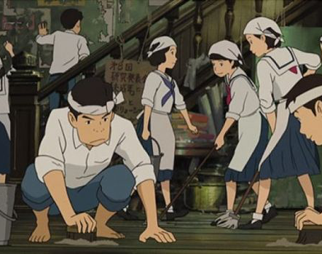
Clean the data
Dropped some redundand columns (eg. japanese_name, name…)
Drop columns with too many “Unknown” value
Drop rows related to “Unknown” values of columns with few of them
Change dtype when possible in numerical or datetime
Check NaN

Slide 6
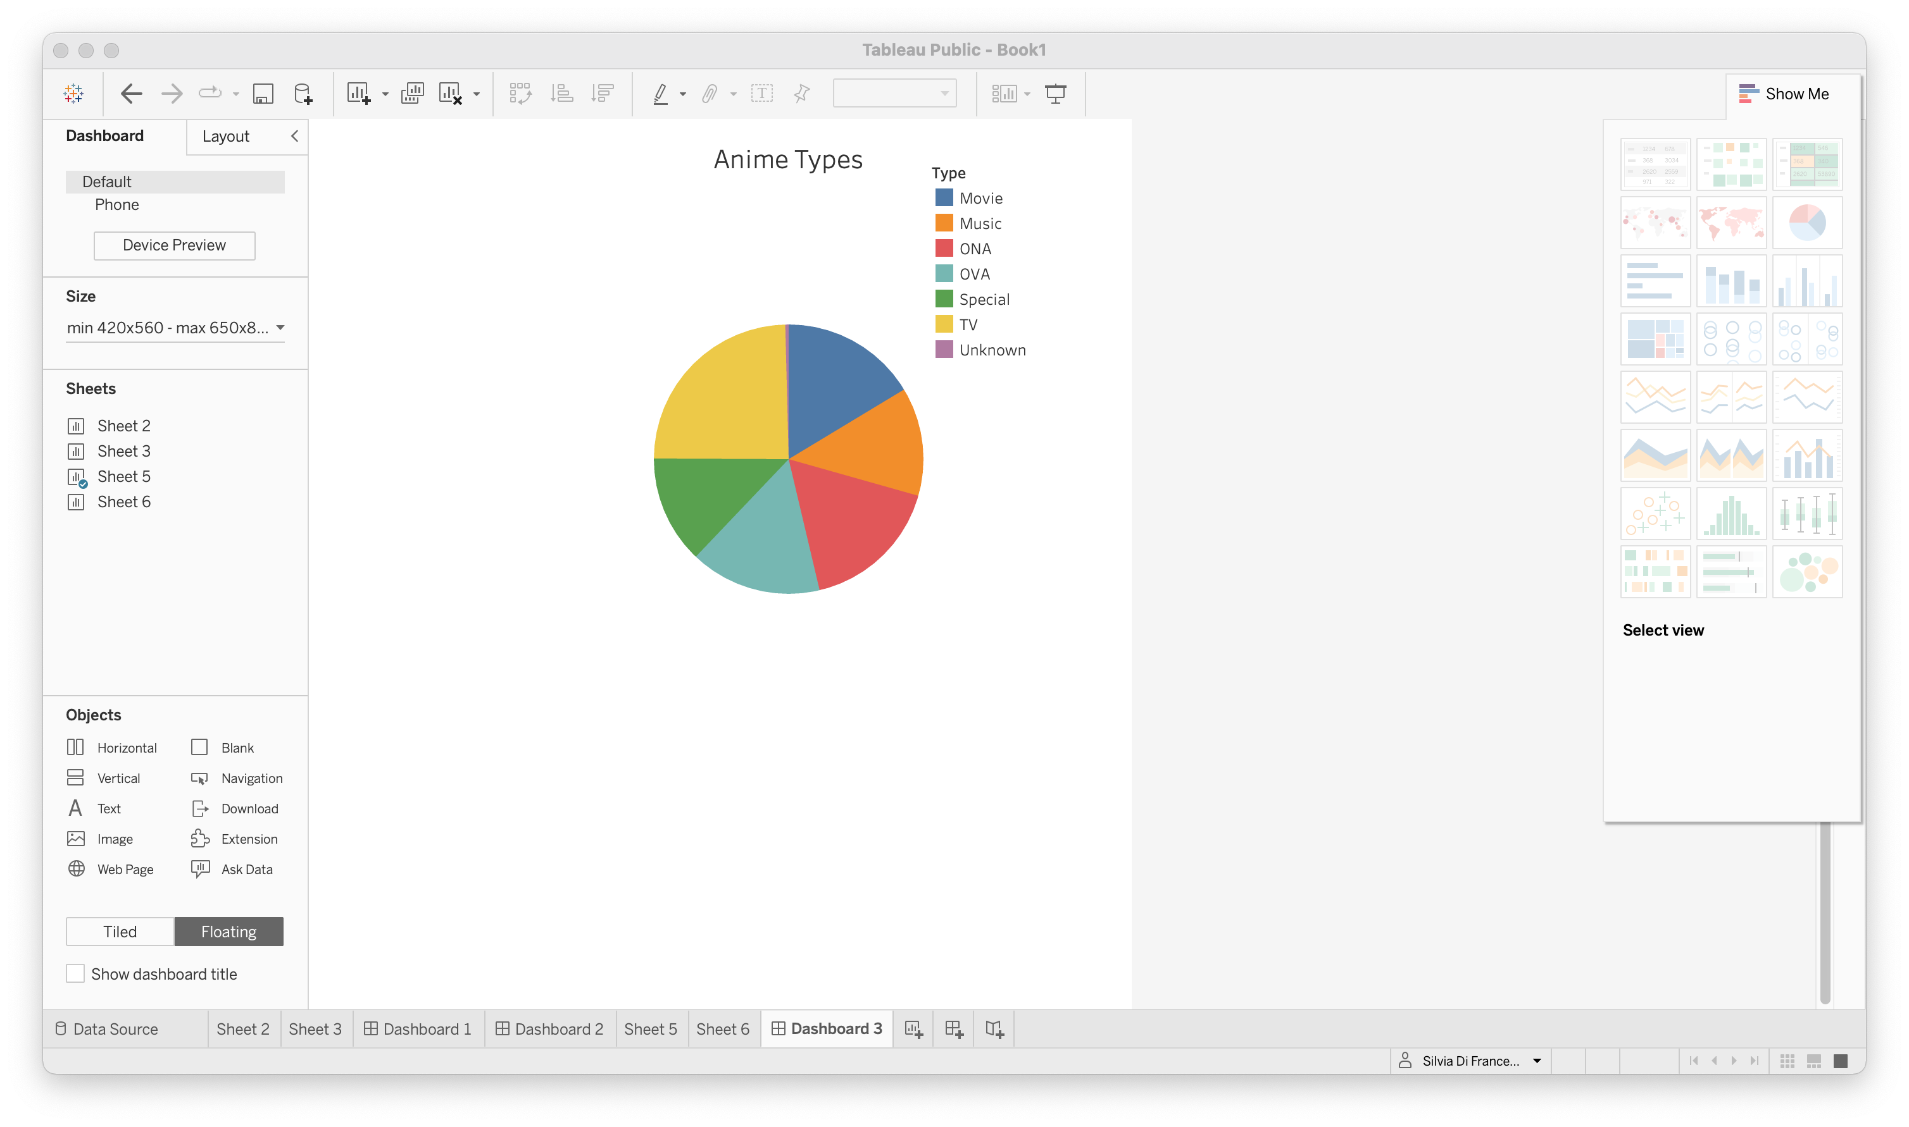
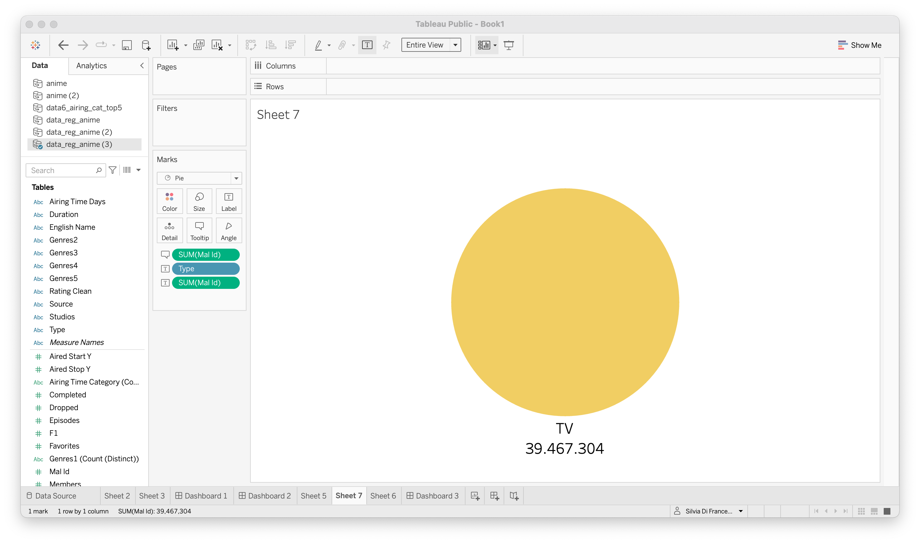
Select the data for my analysis
Anime series (“Type=TV”)

Slide 7
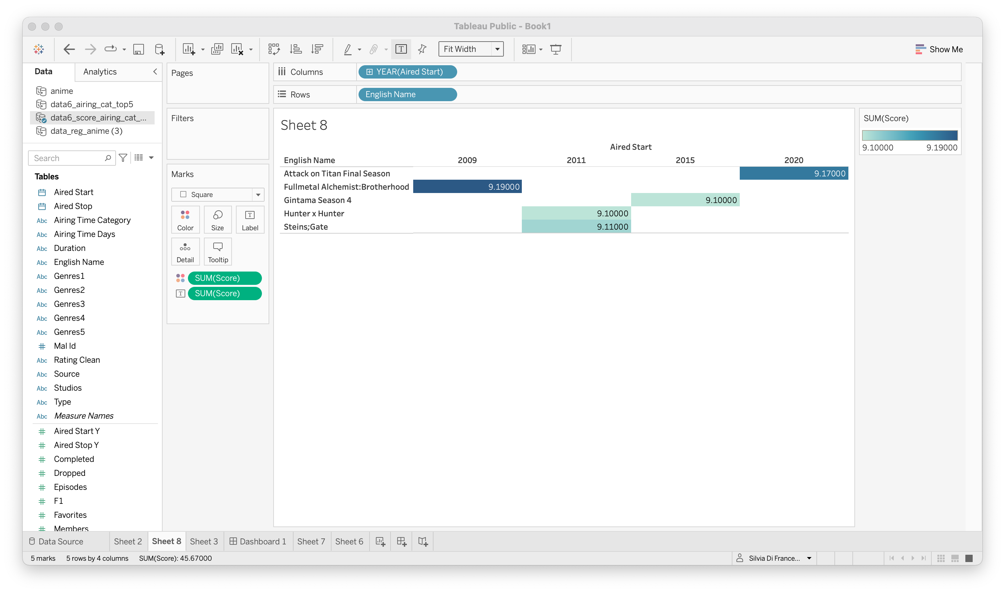
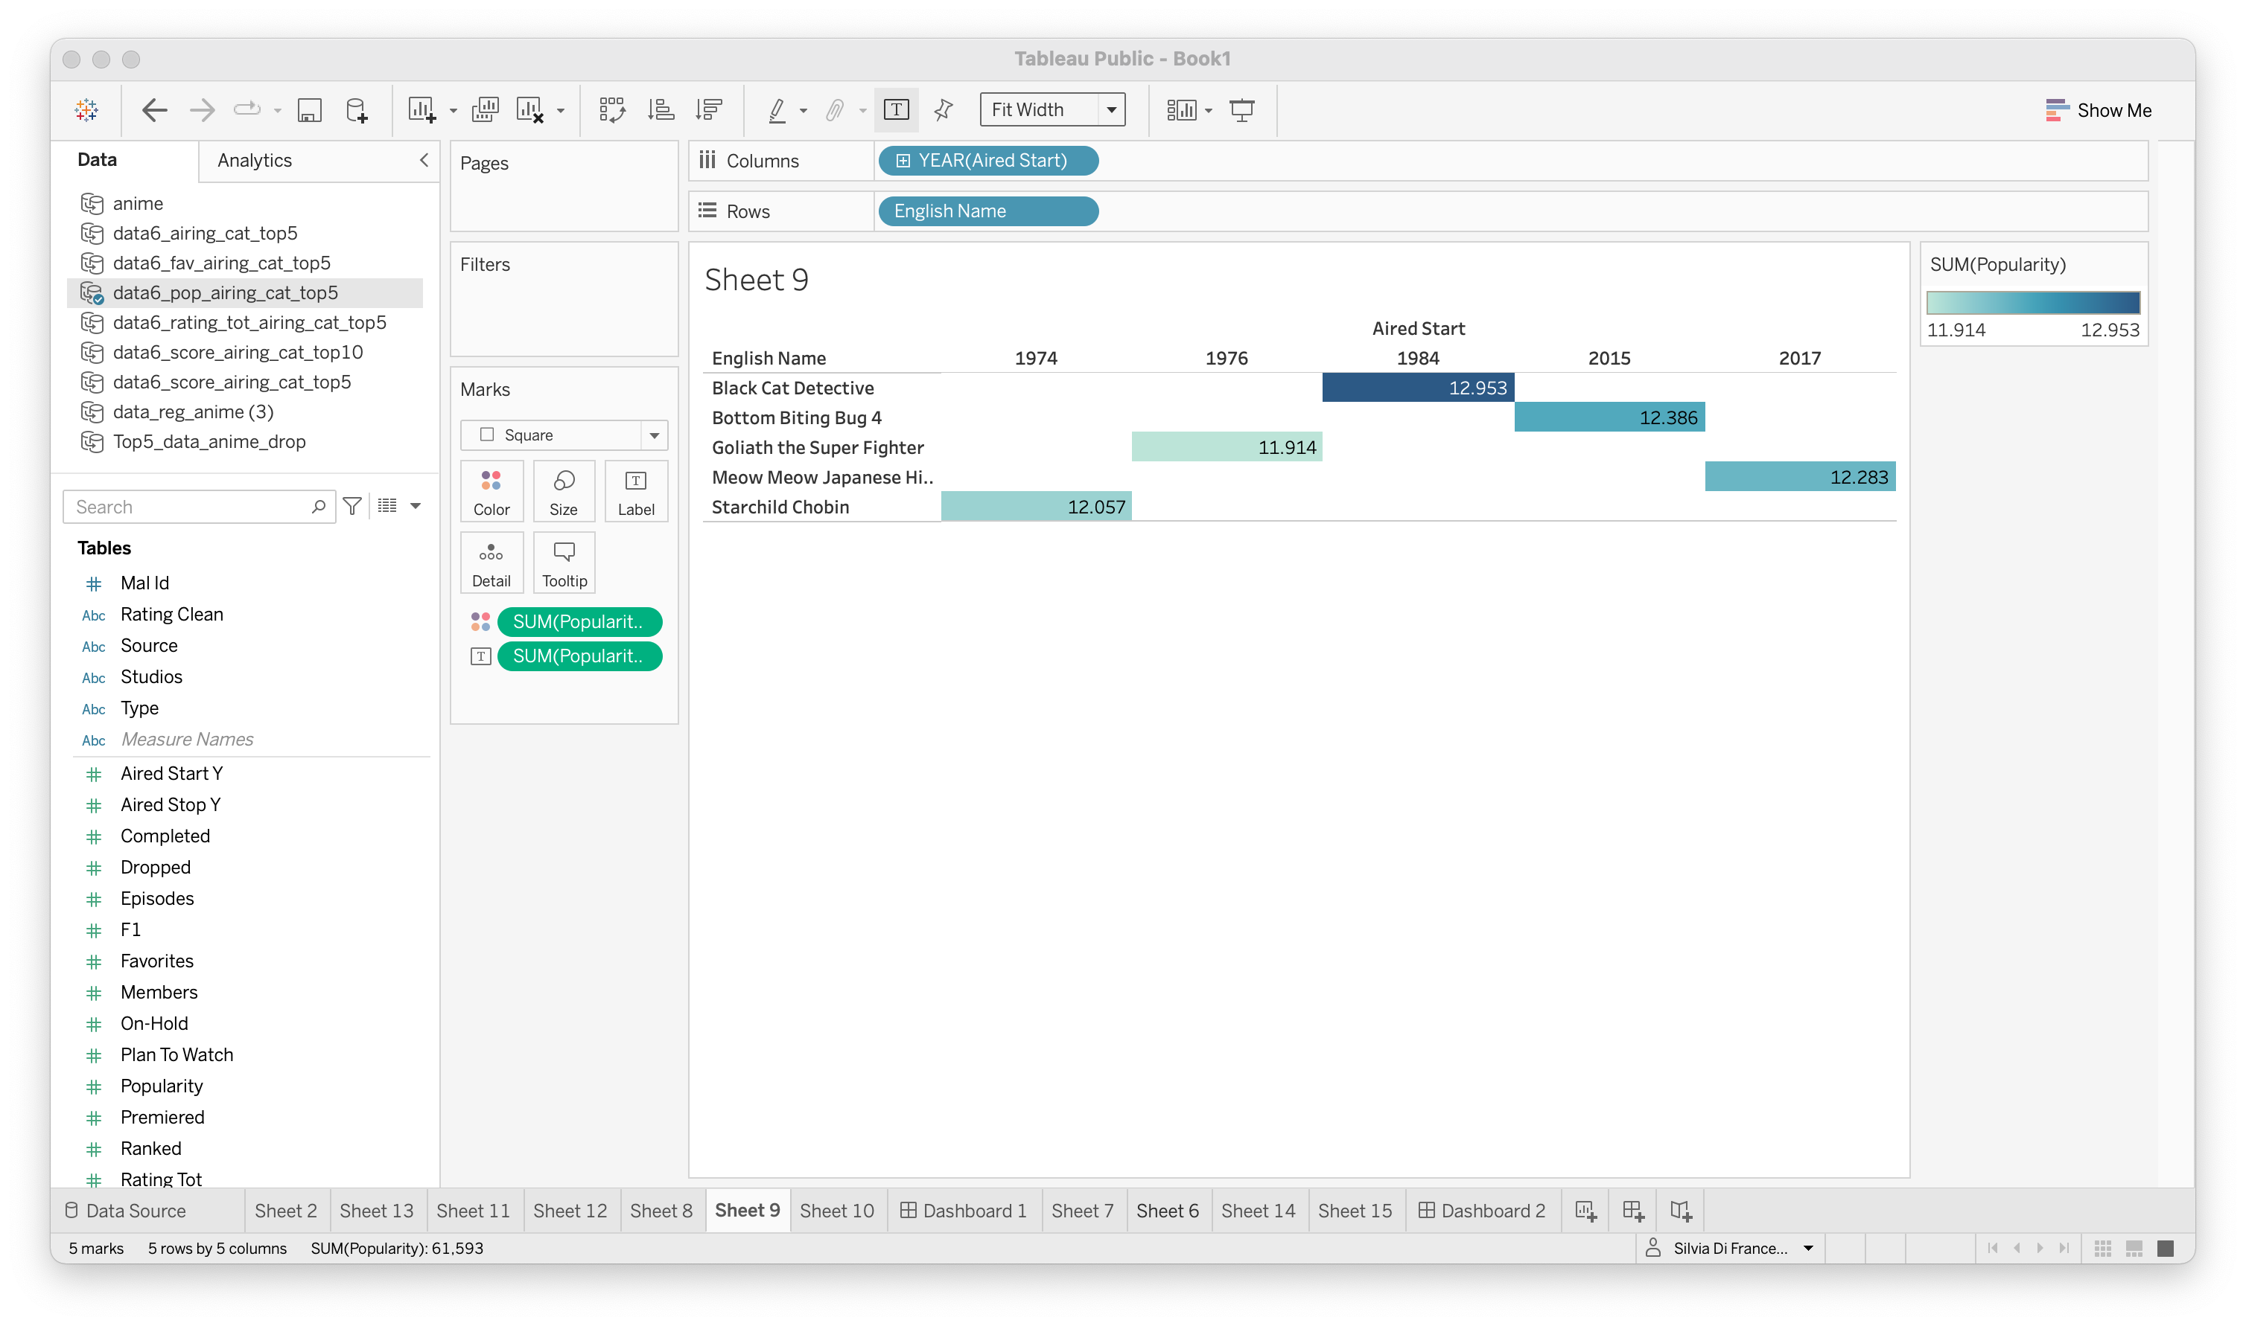
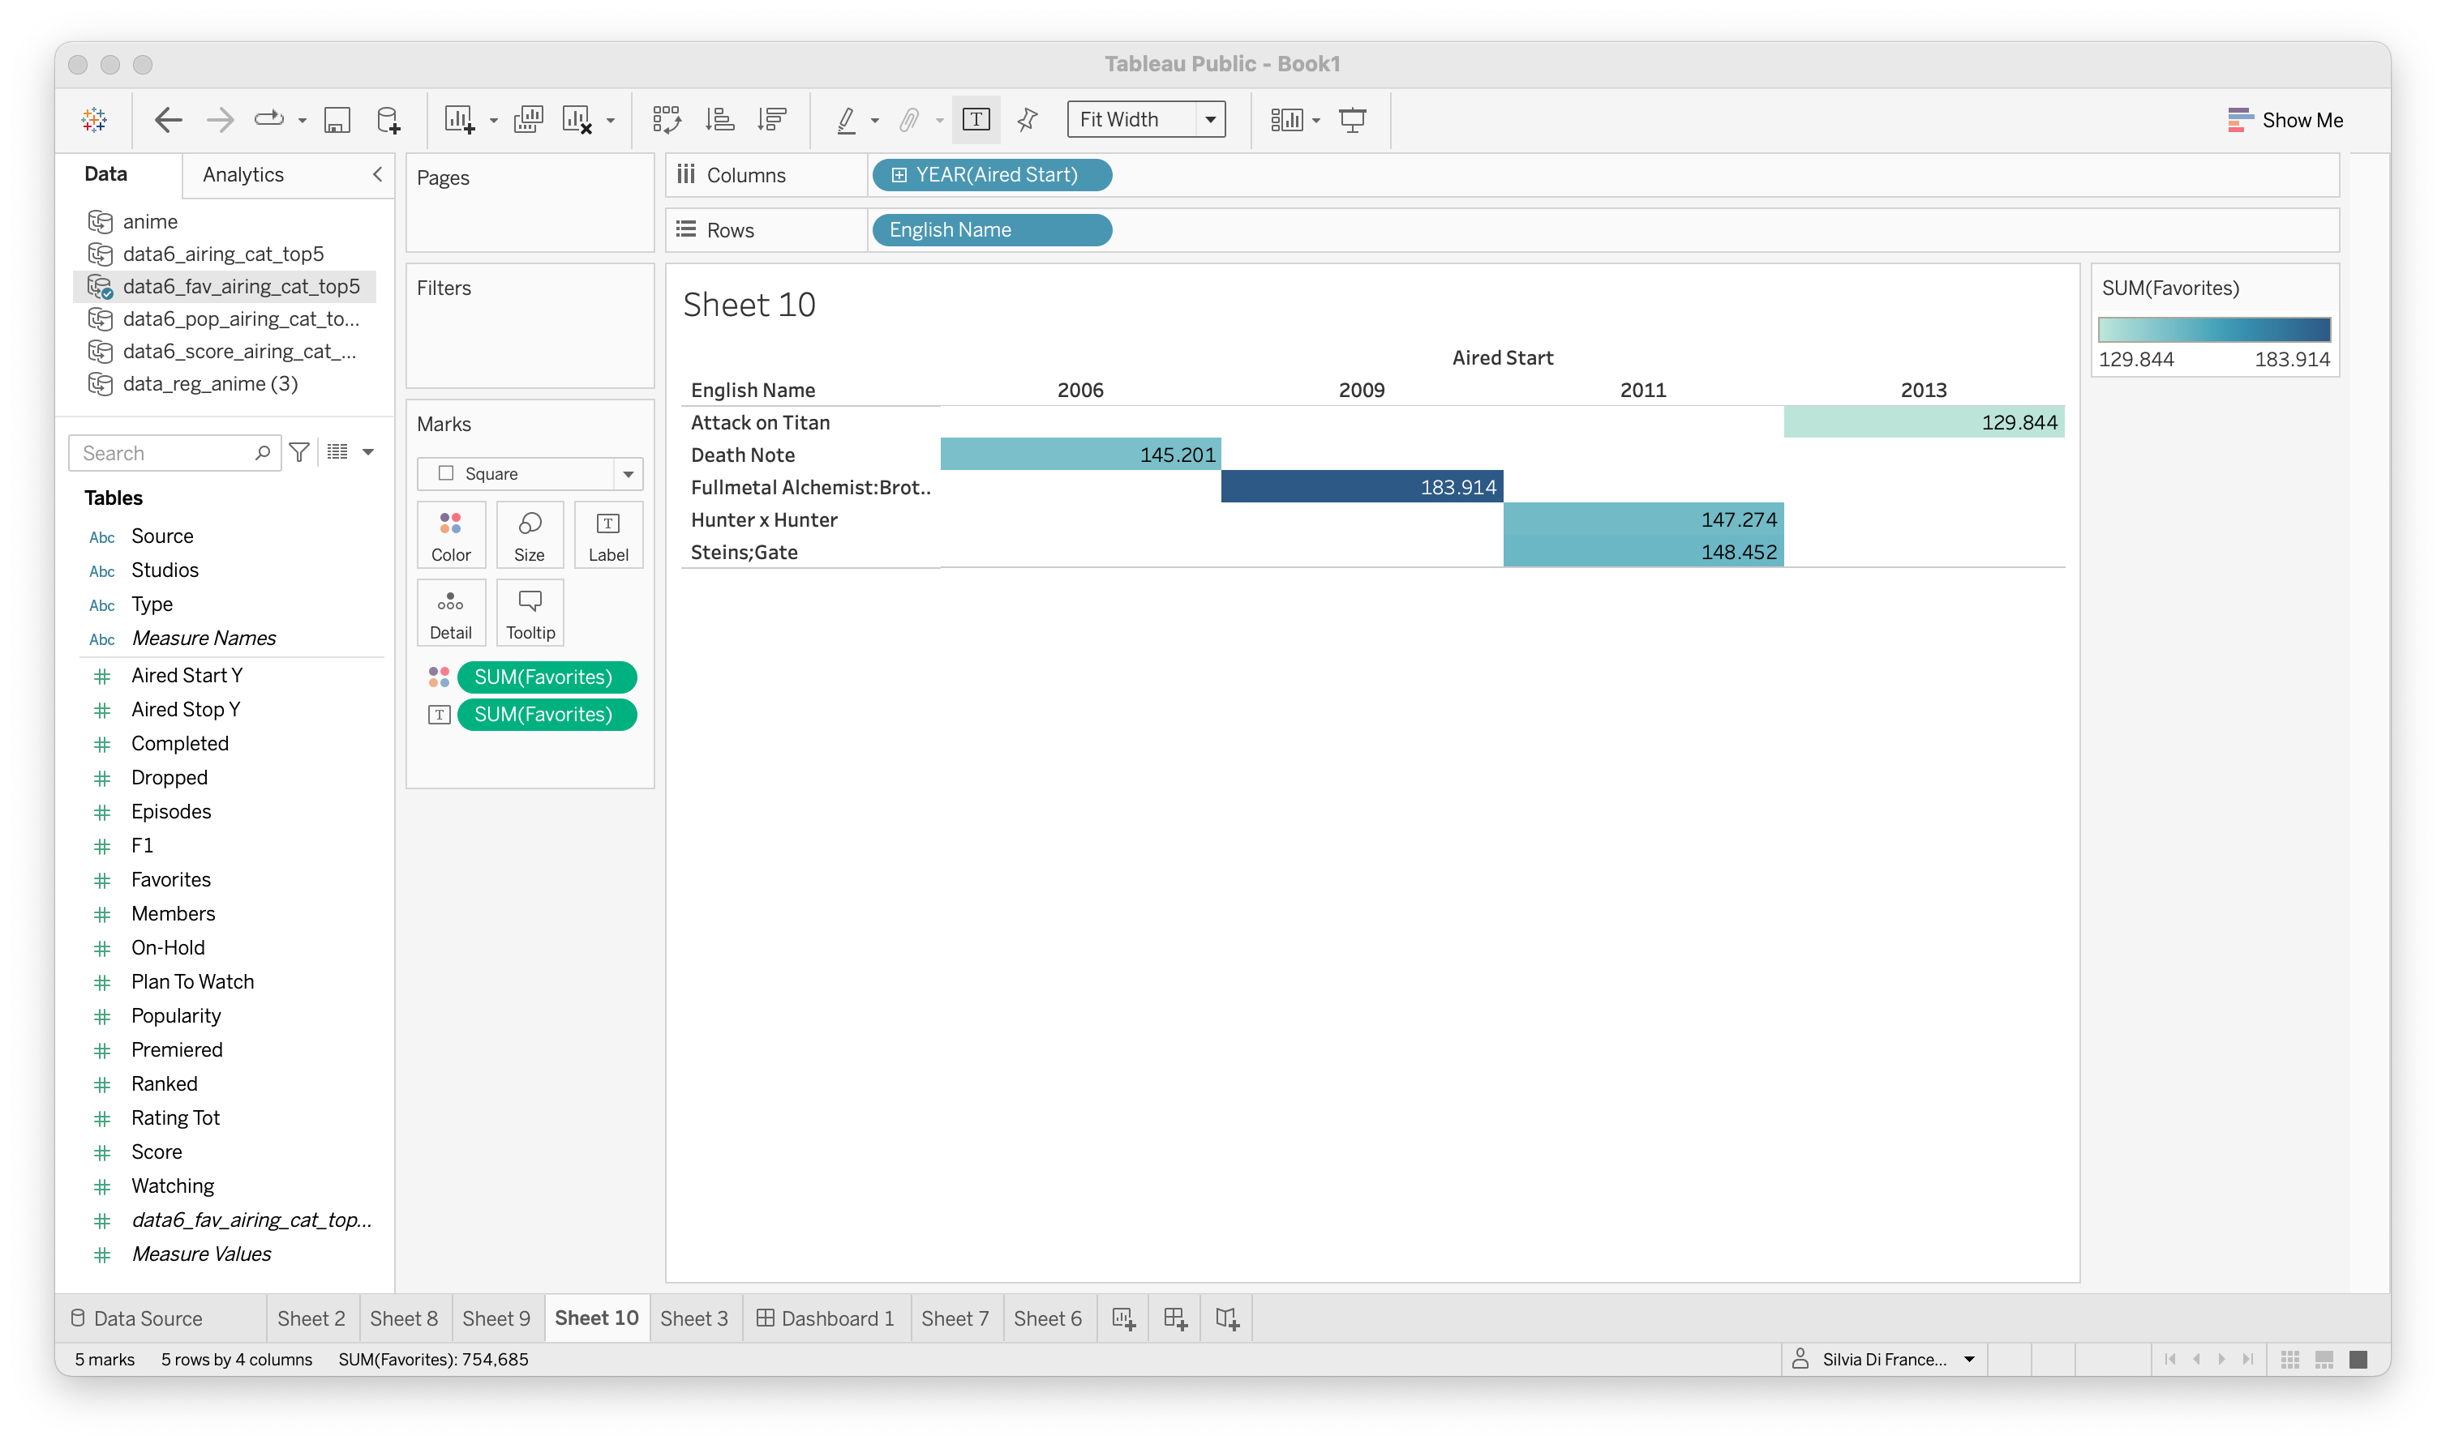
Analysis Top 5 →
Top5_TV : Top5 anime TV according to:
Score: average score of the anime given from all users in MyAnimelist database
Popularity: position based in the the number of users who have added the anime to their list
Observation:
all three are important to predict the best anime so I want to have a score that represent all of them at the same time…
Favourites: number of users who have the anime as "favourites”

Slide 8
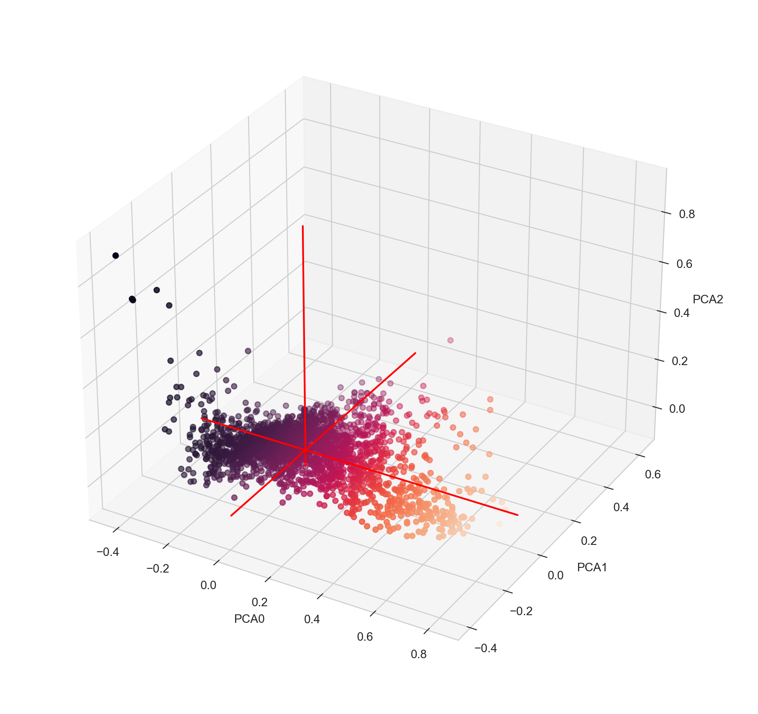
Principal Component Analysis (PCA) plot
linear dimensionality reduction technique that can be utilized for extracting information from a high-dimensional space by projecting it into a lower-dimensional sub-space. It tries to preserve the essential parts that have more variation of the data and remove the non-essential parts with fewer variation
explained variance ratio (first three components): [0.77965065 0.18041804 0.03993131]
PCA0 is the component that better describe the variance between the values.
PCA0 → new column “rating_top”
Notes:
Explained Variance
The explained variance tells you how much information (variance) can be attributed to each of the principal components. This is important as while you can convert 4 dimensional space to 2 dimensional space, you lose some of the variance (information) when you do this. By using the attribute explained_variance_ratio_, you can see that the first principal component contains 72.77% of the variance and the second principal component contains 23.03% of the variance. Together, the two components contain 95.80% of the information.

Slide 9
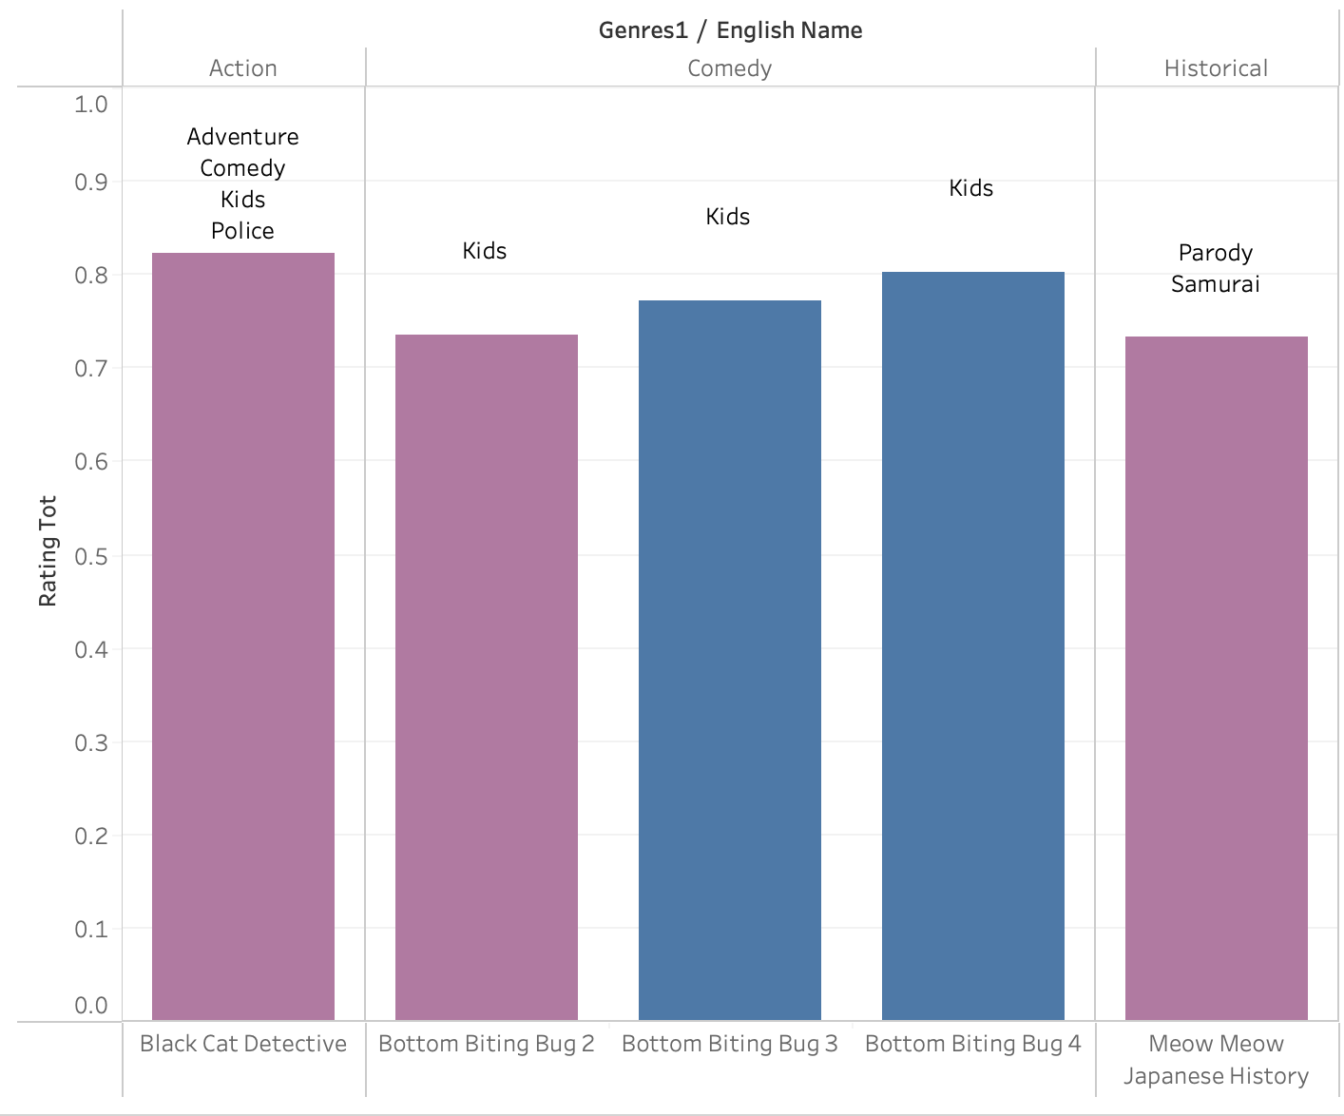
Analysis Top 5
Top5_TV
Top5 anime TV according to
rating_tot = PCA0

Slide 10
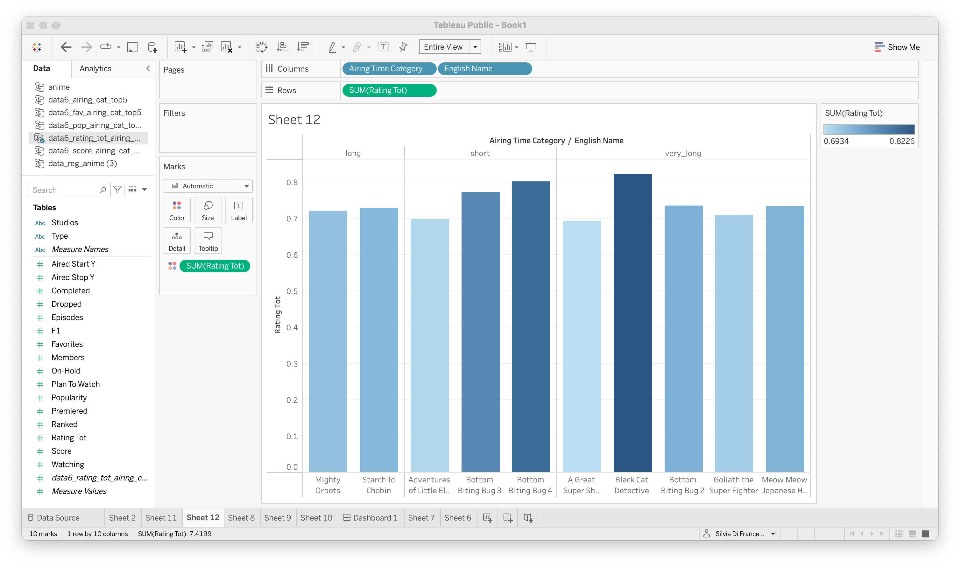
Analysis Top 10 vs. airing_time duration
Top5_TV
Top5 anime TV according to
rating_tot = PCA0 and releted to the airing time categories
very_long
long
medium
short

Slide 11
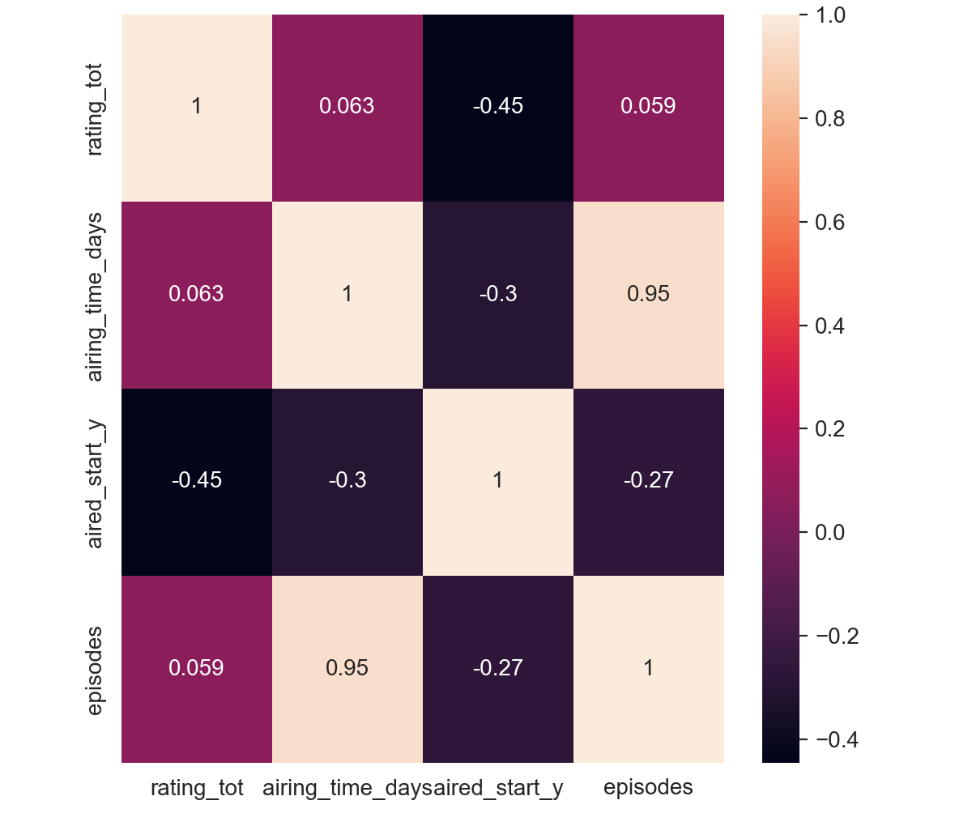
Analysis:
correlation
between
rating_tot and airing
No!

Slide 12

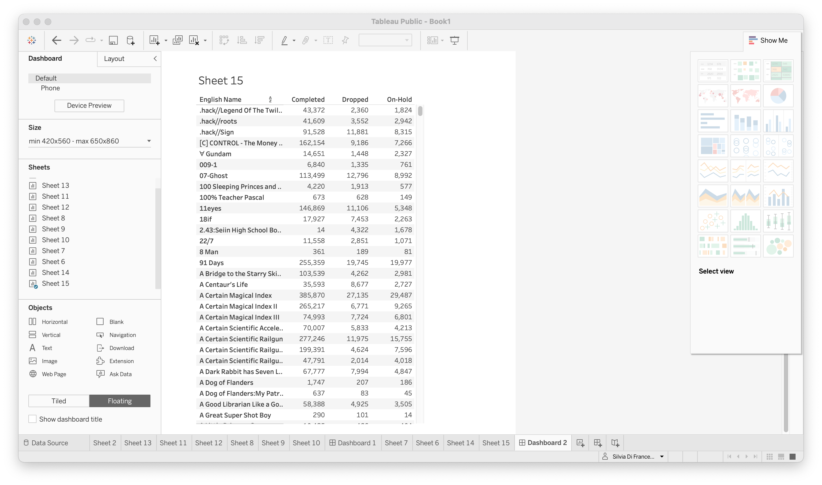
Analysis: modeling Which anime are dropped??
Many anime are dropped! Why? Which types? So sad….
Using this data we can predict the % of users that it´s likely to drop an anime according it´s features (type, genres, studios etc.).

Slide 13
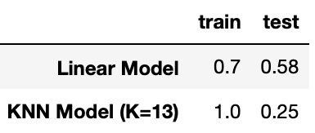
Analysis: modeling Which anime are dropped??
Many anime are dropped! Why? Which types? So sad….
Using this data we can predict the % of users that it´s likely to drop an anime according it´s features (type, genres, studios etc.).
To predict –> y= “dropped_rate”
For the prediction → X= all my columns
Model used → LinerRegression, KNN
“dropped_rate” = to the tot of user that dropped the anime compared to the total of user that started the anime

Slide 14
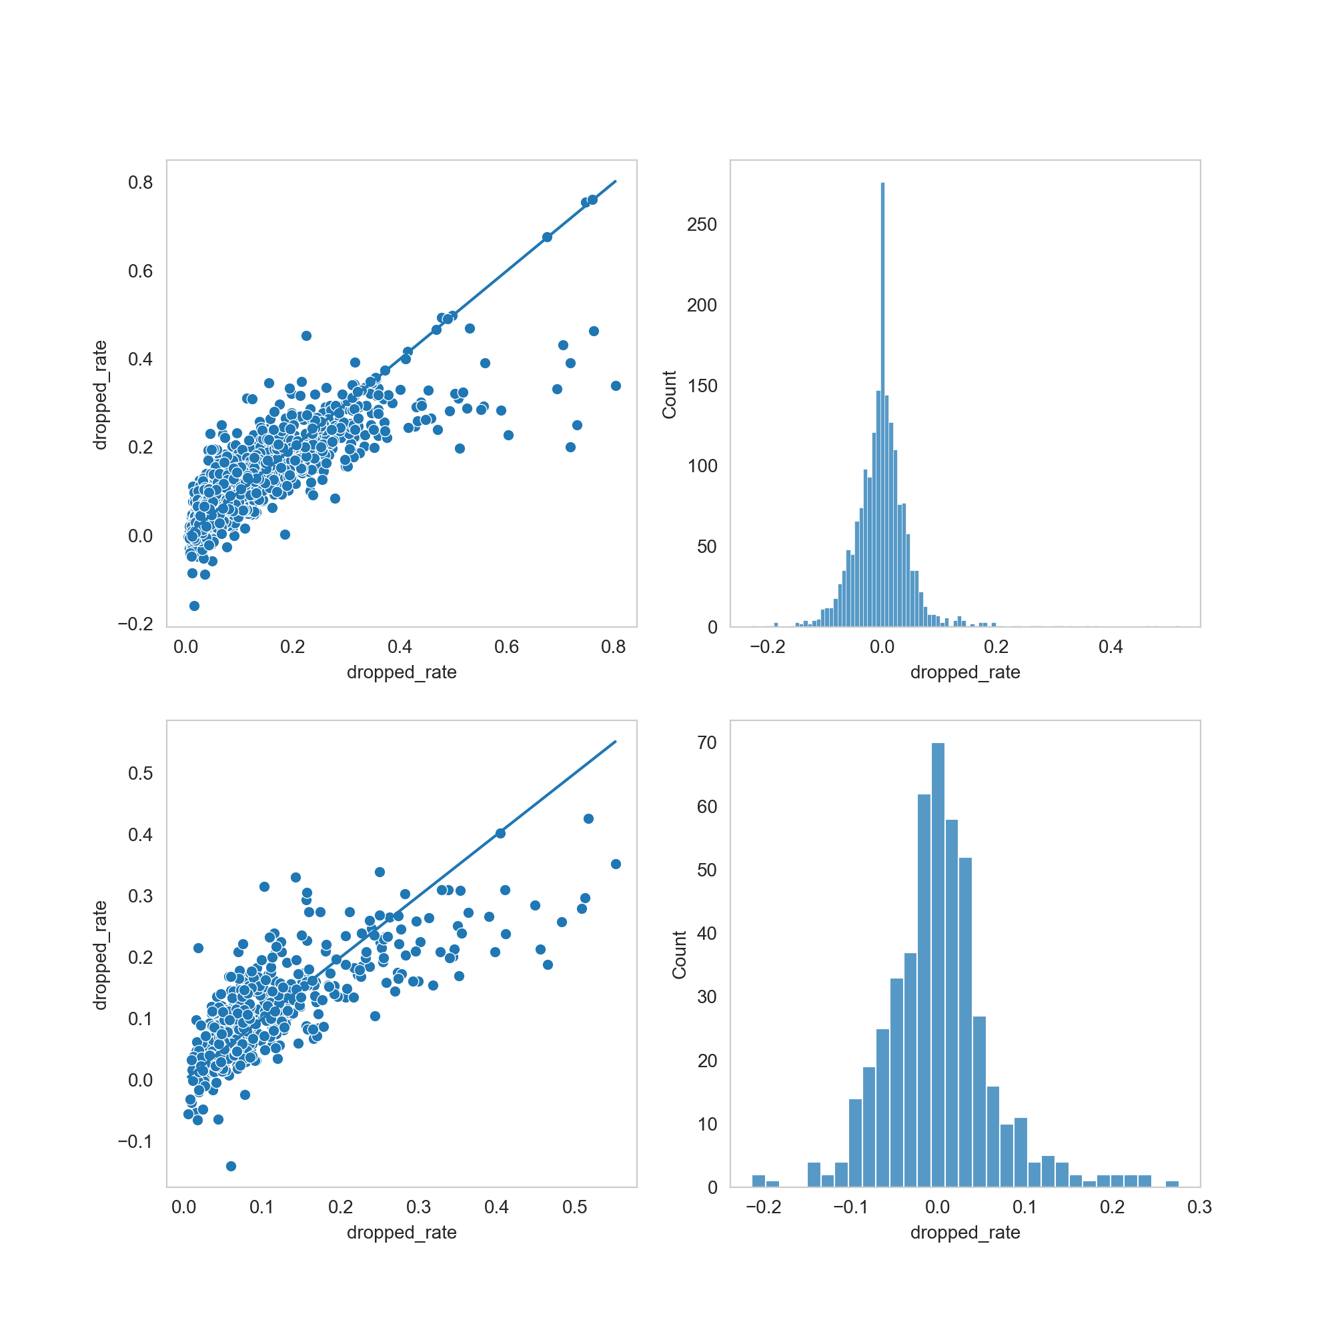
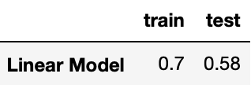
Analysis: modeling Which anime are dropped??
Train
Many anime are dropped! Why? Which types? So sad….
Using this data we can predict the % of users that it´s likely to drop an anime according it´s features (type, genres, studios etc.).
Test
To predict –> y= “dropped_rate”
For the prediction → X= all my columns
Model used → LinerRegression
“dropped_rate” = to the tot of user that dropped the anime compared to the total of user that started the anime

Slide 15
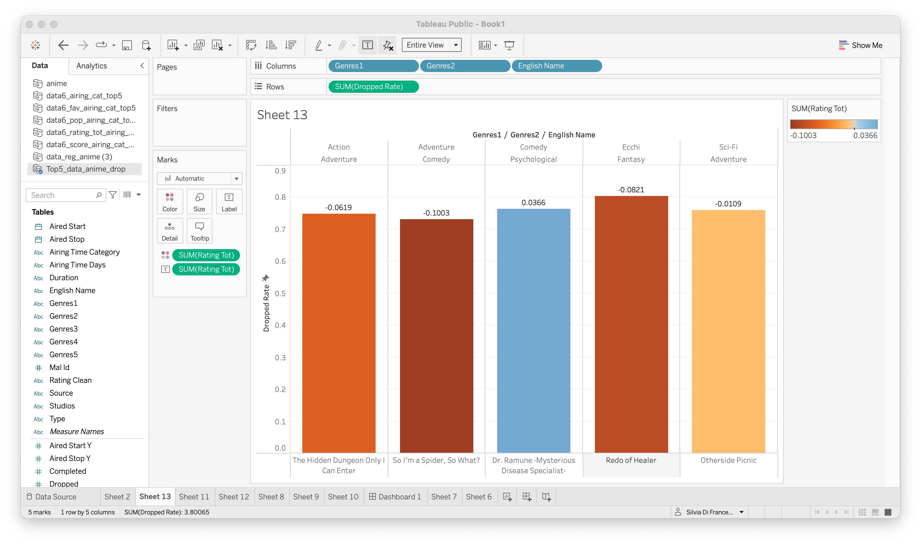

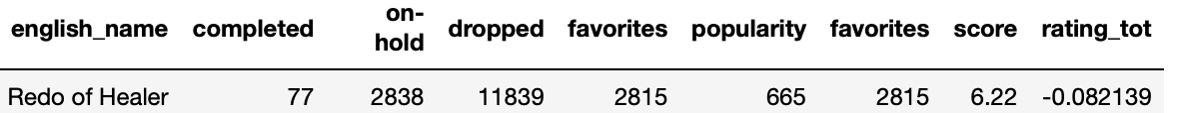
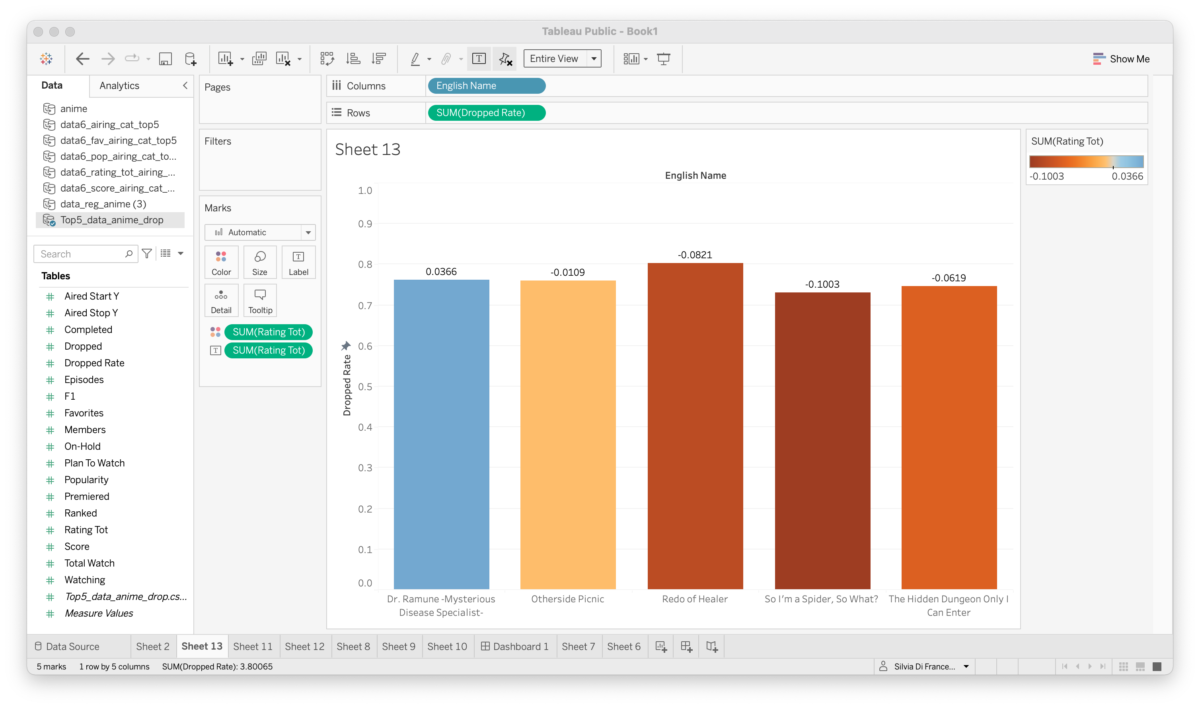
Curiosity I: which anime is the most dropped one?? Is also the worst rated.

Slide 16
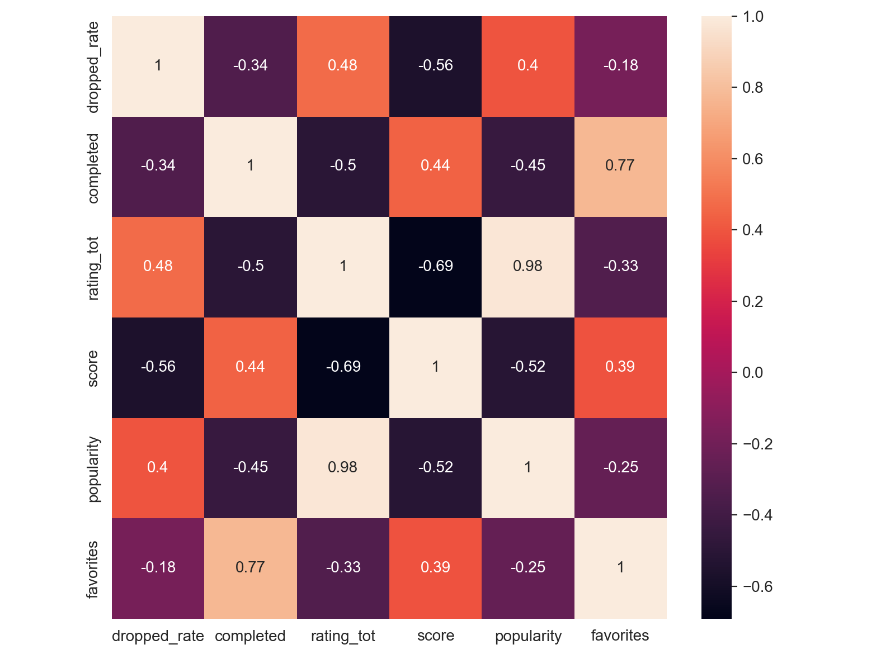
Curiosity II: some correlations…

Slide 17
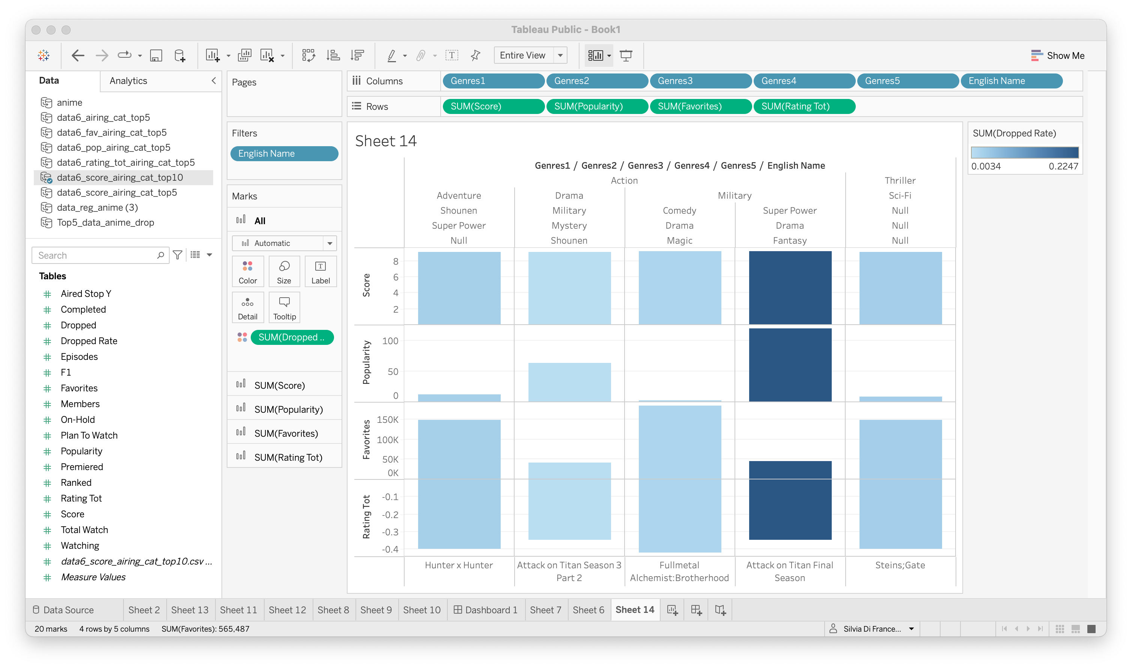

Curiosity III: my favorite ones among the Top10 (scored)….

Slide 18

Conclusions…
Database is very informative. However, score, popularity and favourites are not correlated in difining the best anime.
There are some missing information, “Unknown” values. However, the amount of data are enouch for modelling and predictions.
Interesting to check out good anime to watch!
Analysis for anime_Movie or different types.
Model for predicting the fingherprint of the best anime using the new rating_tot.
…and outlook:
Pic. “Evangelion”

Slide 19
Acknowledgement
Ignacio & Jordi
All my Ironhack colleagues!! ☺
Thank you!!
Questions???

Slide 20


